Slide 1
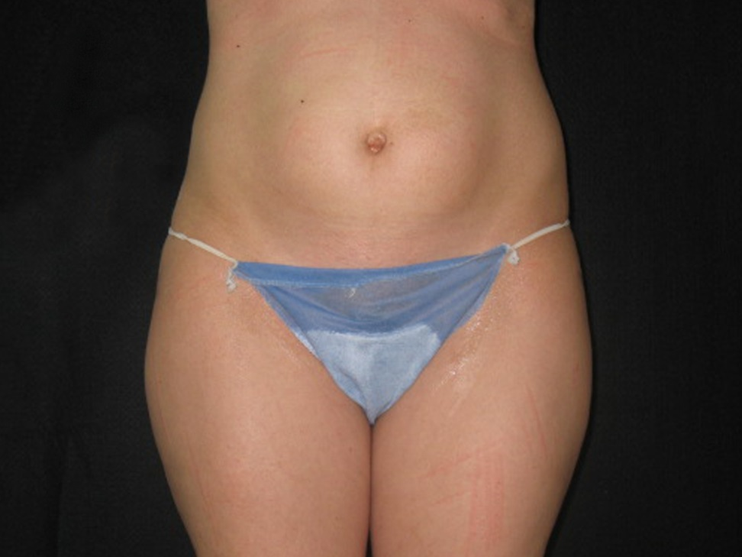
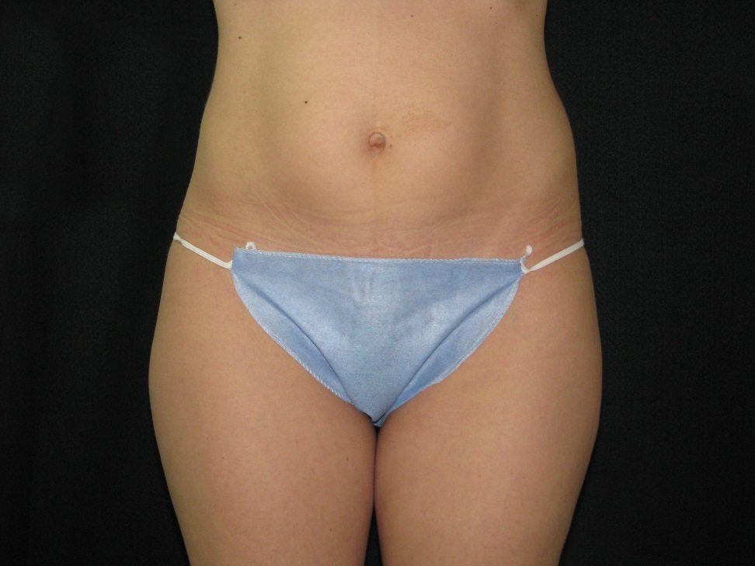
UltraShape Clinical Results
4cm Reduction
Treatment 1- Day 1
Treatment 3- Day 28

Slide 2
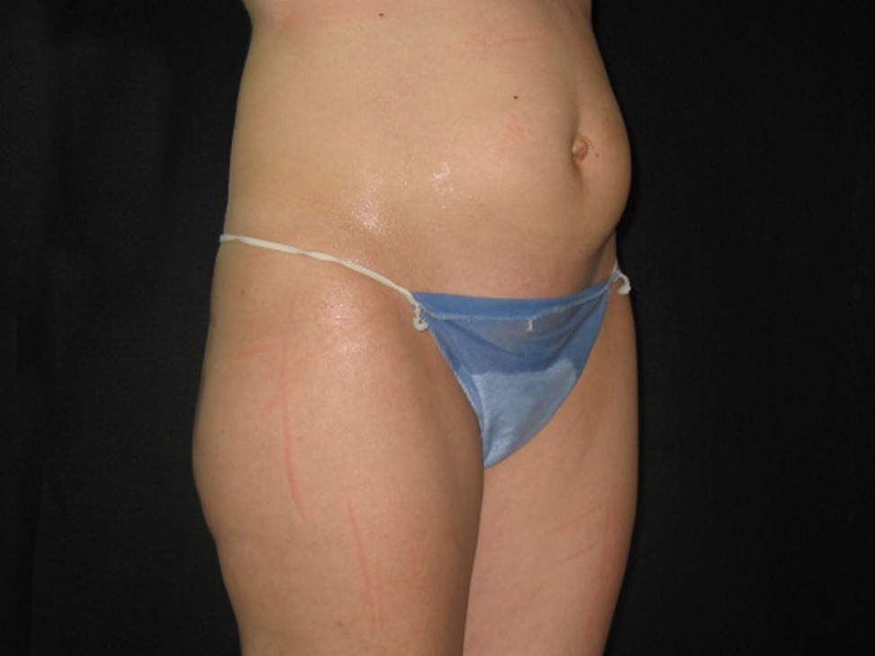
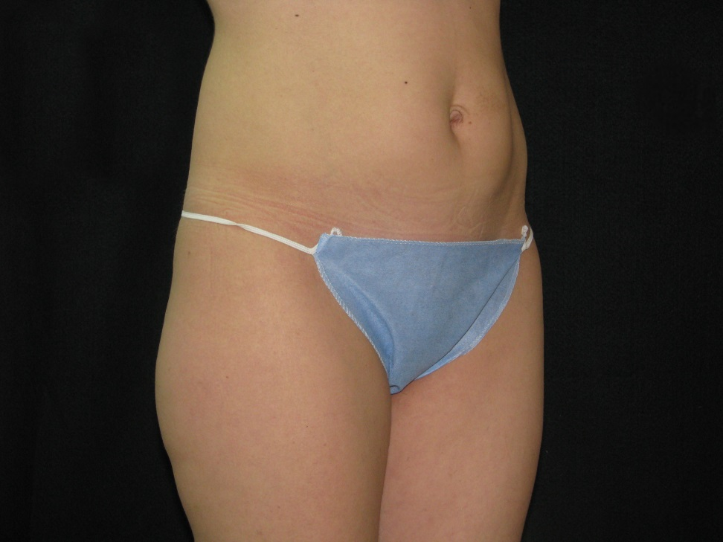
UltraShape Clinical Results
4cm Reduction
Treatment 1- Day 1
Treatment 3- Day 28

Slide 3
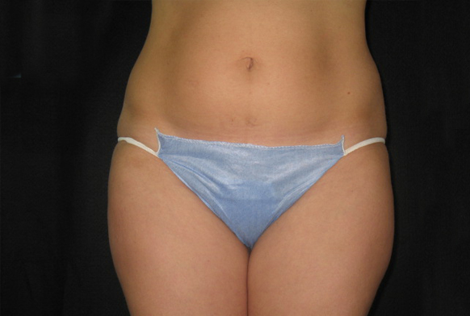
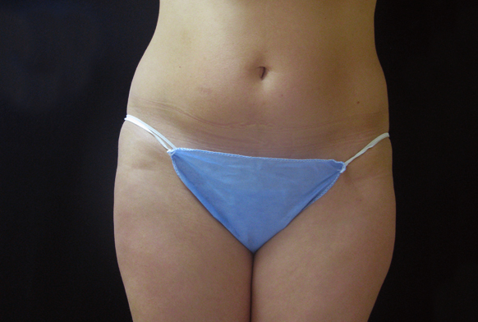
UltraShape Clinical Results
3.6cm Reduction
Treatment 1- Day 1
Treatment 3- Day 28

Slide 4
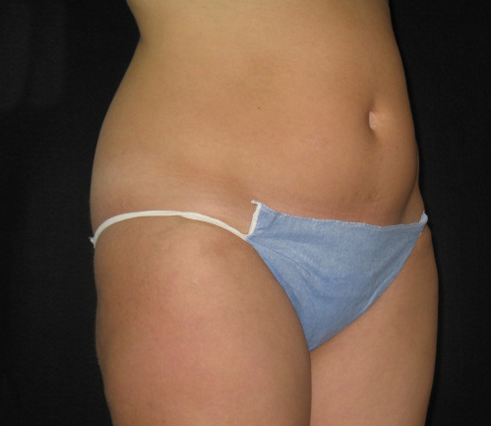
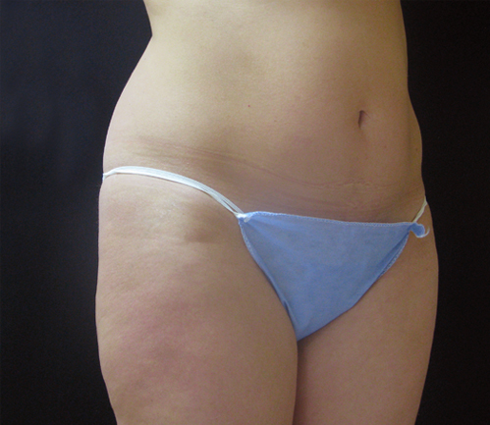
UltraShape Clinical Results
3.6cm Reduction
Treatment 1- Day 1
Treatment 3- Day 28

Slide 5
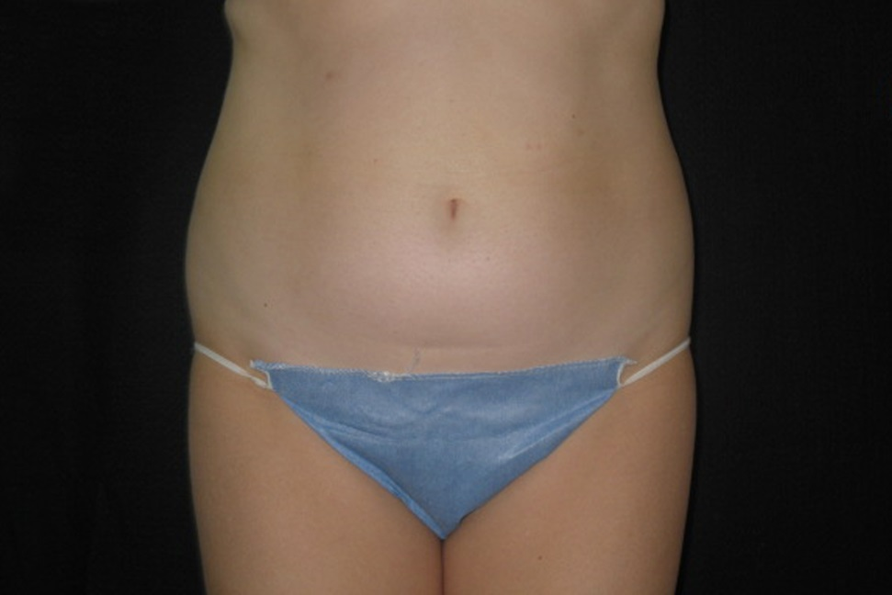
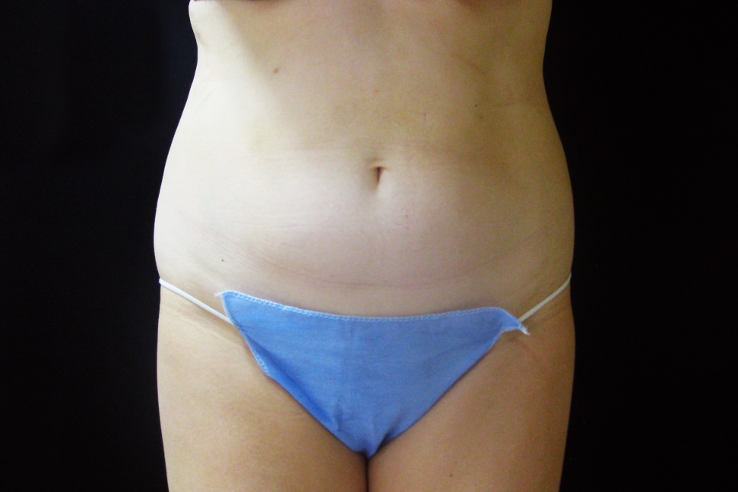
UltraShape Clinical Results
3.8cm Reduction
Treatment 1- Day 1
Treatment 3- Day 28

Slide 6
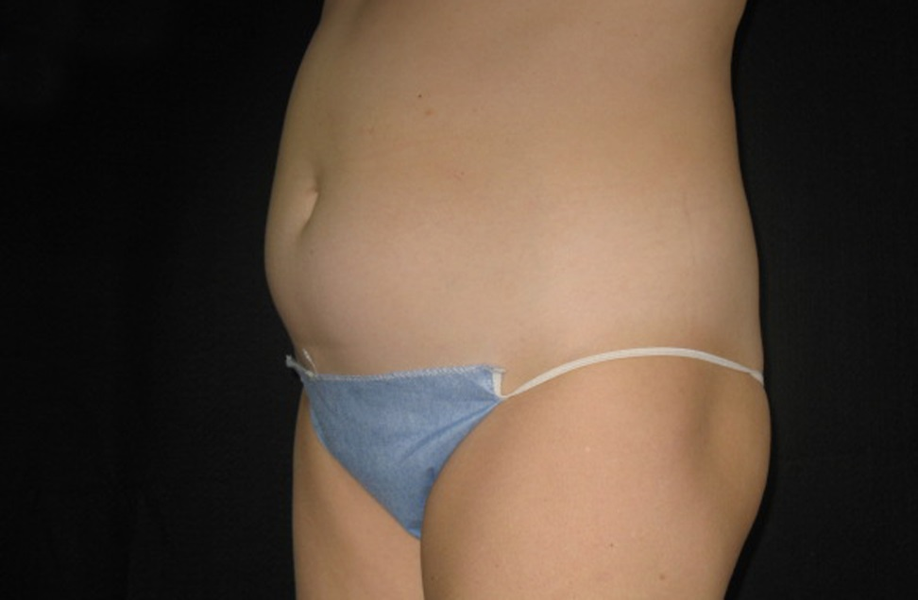
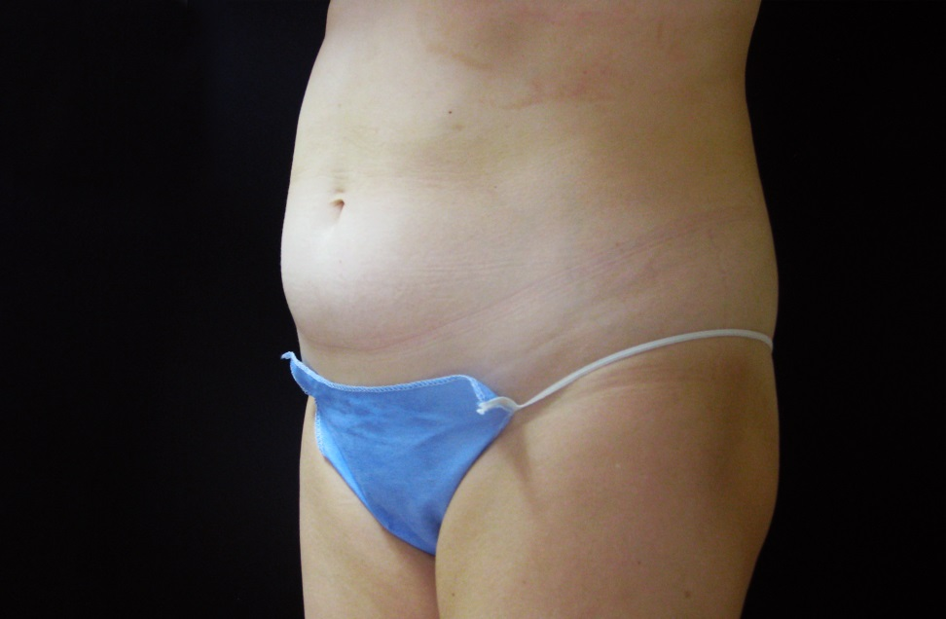
UltraShape Clinical Results
3.8cm Reduction
Treatment 1- Day 1
Treatment 3- Day 28

Slide 7
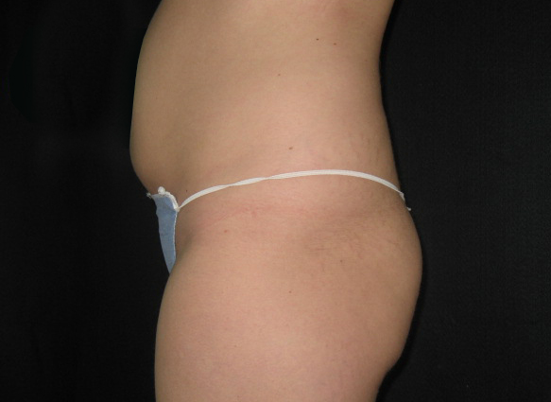
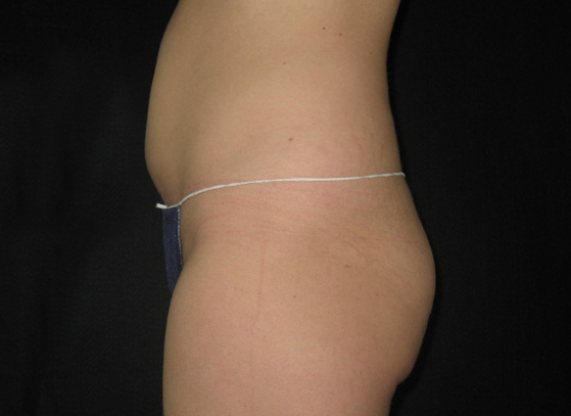
UltraShape Clinical Results
8.1cm Reduction
Treatment 1- Day 1
Follow Up- Day 84

Slide 8
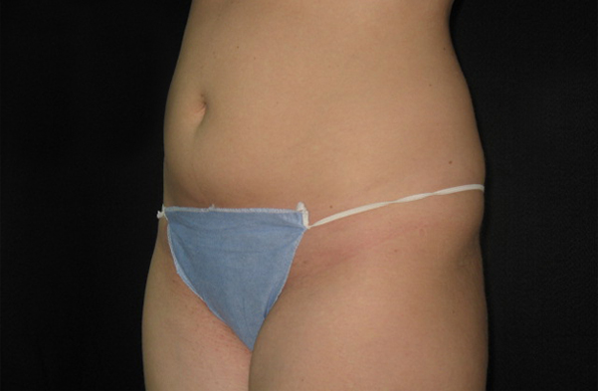
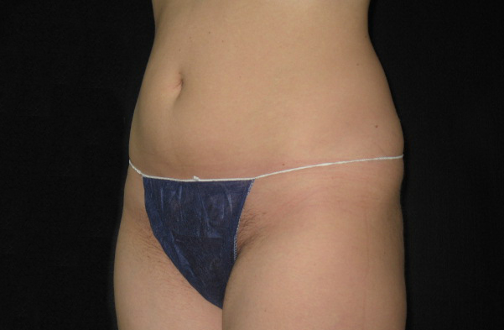
UltraShape Clinical Results
8.1cm Reduction
Treatment 1- Day 1
Follow Up- Day 84

Slide 9
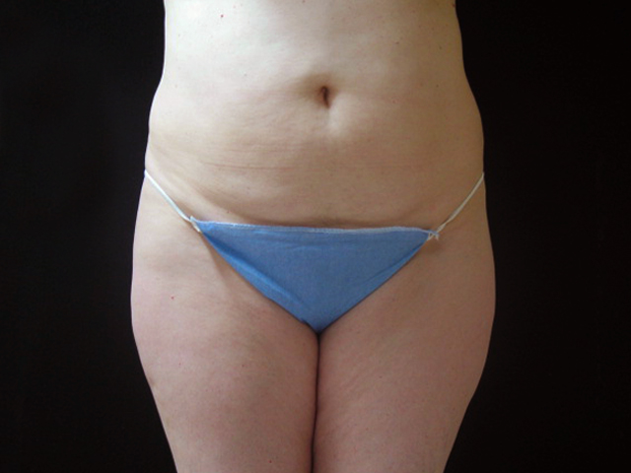
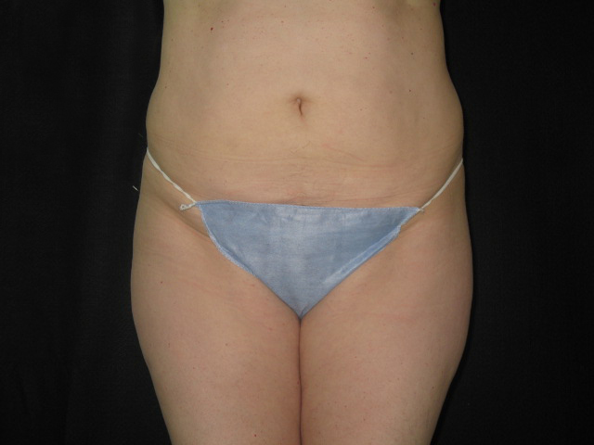
UltraShape Clinical Results
5.3cm Reduction
Treatment 1- Day 1
Follow Up- Day 42

Slide 10
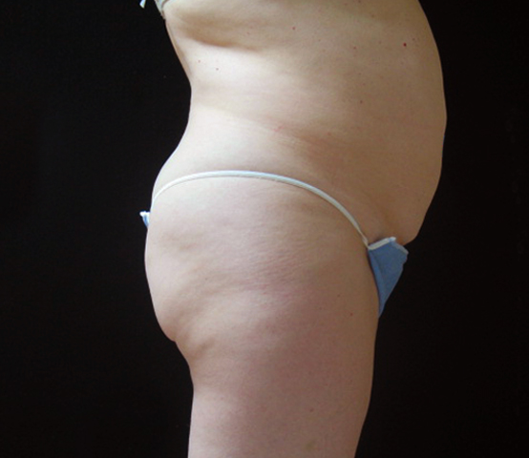
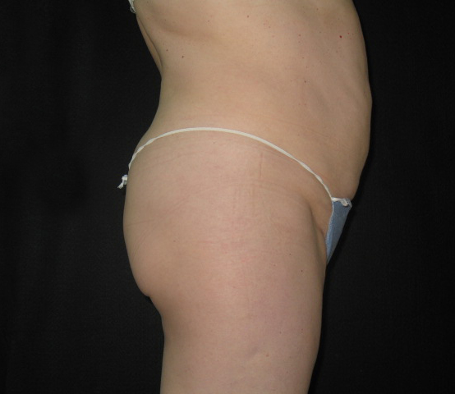
UltraShape Clinical Results
5.3cm Reduction
Treatment 1- Day 1
Follow Up- Day 42

Slide 11
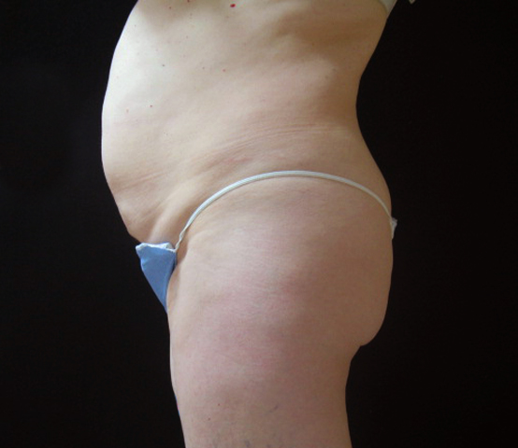
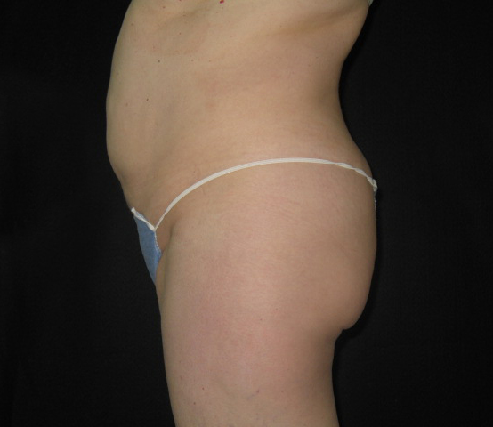
UltraShape Clinical Results
5.3cm Reduction
Treatment 1- Day 1
Treatment 3- Day 28

Slide 12
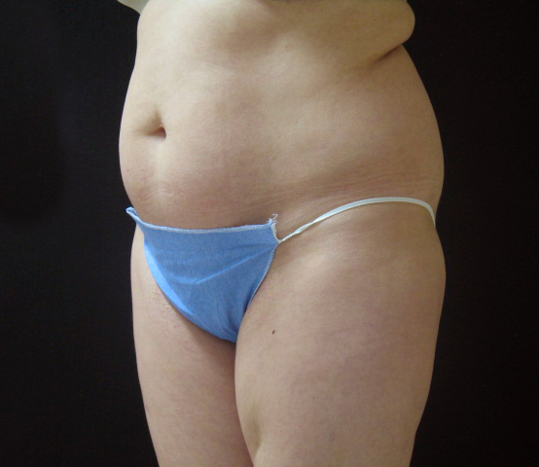
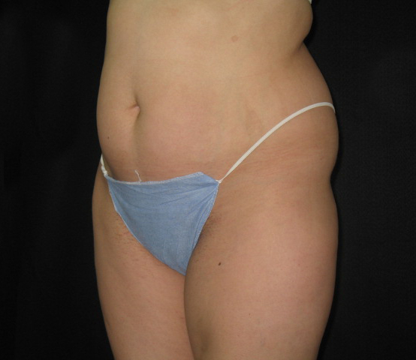
UltraShape Clinical Results
7.9cm Reduction
Treatment 1- Day 1
Treatment 3- Day 28

Slide 13
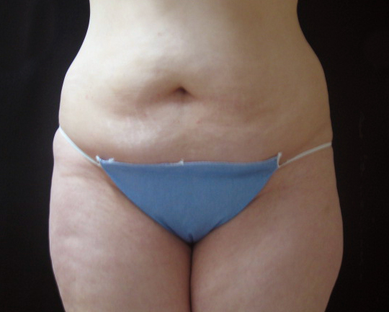
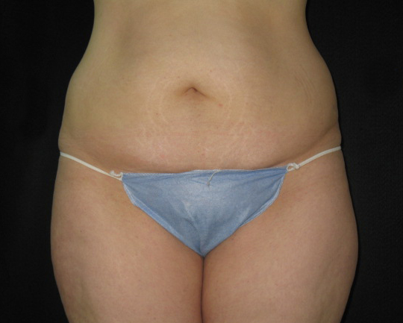
UltraShape Clinical Results
7.7cm Reduction
Treatment 1- Day 1
Treatment 3- Day 28

Slide 14
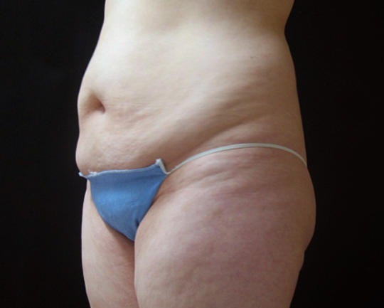
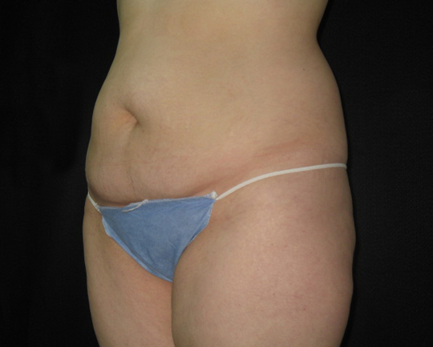
UltraShape Clinical Results
7.7cm Reduction
Treatment 1- Day 1
Treatment 3- Day 28

Slide 15
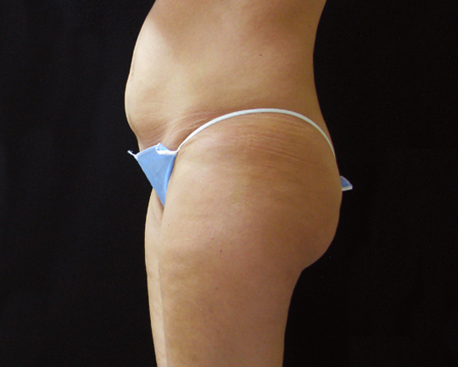
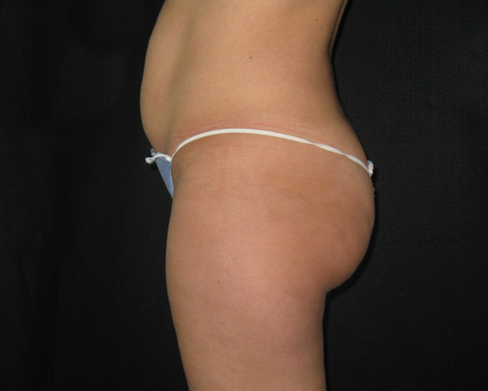
UltraShape Clinical Results
7.7cm Reduction
Treatment 1- Day 1
Treatment 3- Day 28

